Slide 1
Data Communication & Computer Networks
Course Instructor:
Mr. Fakhar Ul Islam

Slide 2
OSI Model's 7 Layers
APPLICATION
Application to Application
APPLICATION
Application to Application
PRESENTATION
HIGHER LAYER
PRESENTATION
SESSION
Application to Application
SESSION
TRANSPORT
Process to Process
TRANSPORT
MIDDLE LAYER
NETWORK
Source to Destination
NETWORK
Router
Source to Destination
DATA LINK
Hop to Hop
Switch
DATA LINK
Hop to Hop
LOWER LAYER
Hub and Repeater
PHYSICAL
PHYSICAL
Physical Medium

Slide 3
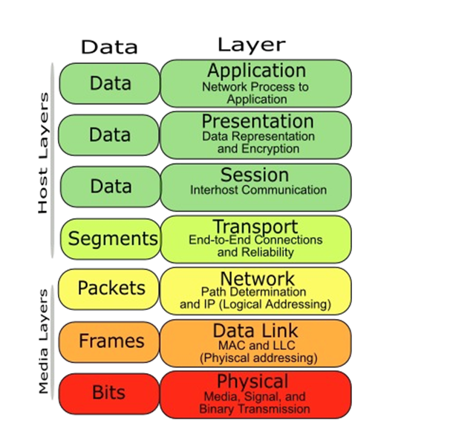
Host and Media Layer

Slide 4
Data, Protocol & Activities
OSI Layers
TCP/IP Suit
Activities
Application
Application
Telnet, FTP, SMTP, HTTP, DNS,, Specific address etc…
To allow access to network resources
Presentation
Presentation
To Translate, encrypt, and compress data
Session
Session
To establish, manage, and terminate session
Transport
Transport
TCP, UDP, Sockets and Ports address
To Provide reliable process-to-process Message delivery and error recovery
Network
Network
IP, ARP/RARP, ICMP,, Logical address
To move packets from source to destination; to provide internetworking
Data Link
Data Link
IEEE 802 Standards, TR, PPP, Physical address
To organize bits into frames; to provide Hop-to-hop delivery
Physical
Physical
Medium, Coax, Fiber, Wireless
To Transmit bits over a medium; to provide Mechanical and electrical specifications

Slide 5

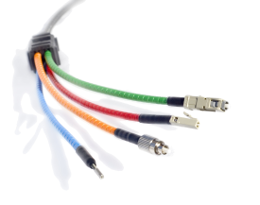

Physical Layer
From data link layer
To data link layer
110 | 10101000000010111
110 | 10101000000010111
Physical layer
Physical layer
Transmission medium
■
One of the major function of the physical layer is to move data in the form of electromagnetic signals across a transmission medium.
Its responsible for movements of individual bits from one hop (Node) to next. Both data and the signals can be either analog or digital.
Transmission media work by conducting energy along a physical path which can be wired or wireless
■
■
■
■
Concerned:
❑
❑
❑
❑
❑
❑
❑
Physical characteristics of interface and medium (Transmission medium)
Representation of bits (stream of bits (0s or 1s) with encoded into signals)
Data rate (duration of a bit, which is how long it last)
Synchronization of bits (sender and receivers clock must be synchronized) Line configuration (Point-to-Point, Point-to-Multipoint)
Physical topology
Transmission mode (Simplex, half duplex, full duplex)

Slide 6
Data Link Layer (Host to Host)
From network layer
To network layer
Data link layer
H2
Data
T2
H2
Data
T2
Data link layer
To physical layer
From physical layer
■
Data link layer is responsible for moving frames from one hop (Node) to the next.
■
Concerned:
❑
❑
❑
❑
❑
Framing (stream of bits into manageable data units) Physical addressing (MAC Address)
Flow Control (mechanism for overwhelming the receiver) Error Control (trailer, retransmission)
Access Control (defining master device in the same link)

Slide 7
Network Layer (Source to Destination)
From transport layer
To transport layer
Network layer
H3
Data
Packet
H3
Data
Packet
Network layer
To data link layer
From data link layer
■
The network layer is responsible for the delivery of individual packets from the source host to the destination host.
■
Concerned:
❑
❑
Logical addressing (IP Address)
Routing (Source to destination transmission between networks)

Slide 8
Transport Layer (Process to Process)
From session layer
From session layer
Transport layer
H4 | Data |  | H4 | Data
Transport layer
H4 | Data
H4 | Data
H4
Data
H4 | Data
Segments
Segments
To network layer
From network layer
■
The transport layer is responsible for the delivery of a message from one process to another
■
Concerned:
❑
❑
❑
❑
❑
Service-point addressing (Port address) Segmentation and reassembly (Sequence number)
Connection control (Connectionless or connection oriented) Flow control (end to end)
Error Control (Process to Process)

Slide 9


Session Layer (Dialog initiation)
From Presentation layer
To Presentation layer
Session layer
H5
Data
Data
Data
H5
Data
Data
Data
Session layer
Syn
Syn
Syn
Syn
Syn
Syn
To transport layer
From transport layer
■
The session layer is responsible for dialog control and synchronization
■
Concerned:
❑
❑
Dialog Control (Half Duplex/Full duplex)
Synchronization (Synchronization points, process inline within same page)

Slide 10
Presentation Layer
From application layer
To application layer
presentation layer
H6
Data
H6
Data
presentation layer
To session layer
From session layer
■
The presentation layer is responsible for translation, compression and encryption
■
Concerned:
❑
❑
❑
Translation (interoperability between different encoding system) Encryption (Privacy schemes)
Compression (data compression)

Slide 11
Application Layer (user level service)
USER
(Human or Program)
USER
(Human or Program)
X.500
FTAM
X.400
X.500
FTAM
X.400
Application layer
Application layer
H7
Data
Message
H7
Data
Message
To presentation layer
From presentation layer
■
The application layer is responsible for providing services to the user.
■
Concerned:
❑
❑
❑
❑
Network virtual terminal (Software) File transfer, access and management Mail services
Directory services (access to distributed database sources for global information about various objects and services)
Notes:
File Transfer Access and Management (FTAM)
X.500 and X.400 are the standards, like phone directory.

Slide 12
Q/A

